Slide 1
Distributed memory programming using MPI
CS121 Parallel Computing
Fall 2021

Slide 2
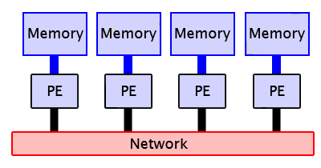
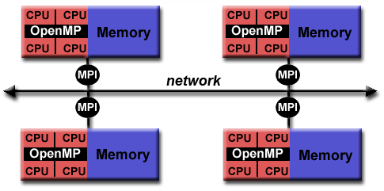
Distributed memory programming
Processes have local memory, and communicate by sending messages over network.
Use standard C / C++ / Fortran. Call library for communication functions.
Message Passing Interface (MPI)
Library developed by academics and industry in early 1990’s.
Standardized clutter of existing HPC languages and tools.
Goals are portability, efficiency and flexibility.
Three versions
MPI 1.1-1.3, Jun 1995 – May 2008
MPI 2.1-2.2, Sep 2008 – Sep 2009
MPI 3.1, Jun 2015
Defines an interface of message passing routines, but not implementation.
Vendors create own implementations optimized for their hardware.
MPICH (Argonne National Laboratory) and OpenMPI are most widely used implementations.
Also commercial implementations from Intel, Microsoft, etc.

Slide 3
Structure of MPI
MPI contains four main types of functions.
Process creation
Divide the program into separate processes that can be executed on different processors.
Sending and receiving messages
Point to point vs collective communication.
In contrast to shared memory programming where processes interact by reading and writing shared data in memory.
Newer versions of MPI also support shared memory style (one way) remote memory access.
Defining new derived data types.
Defining and structuring communication groups.
Communicators organize processes performing common task.
Define topologies for efficient communication.

Slide 4
Process model
MPI based on SPMD (single program multiple data).
Same program runs on different processors.
Processes do different things based on their ID.
Different from Single Instruction Multiple Data (SIMD)!
Processes aren’t synchronized, and can execute different instructions or different branches of code.
Process mapping
Typically map one process to each processor / core.
More processes can cause thrashing, though may also help reduce idling.
Programmer can’t control the mapping.
Source file
compile to suit processors
Executable
Executable
Processor 0
Processor p-1

Slide 5
Process creation example
Include mpi.h
Must call MPI_Init and MPI_Finalize before and after using MPI functions.
#include <mpi.h>
main(int argc, char *argv[]) {
int npes, myrank;
MPI_Init(&argc, &argv);
MPI_Comm_size(MPI_COMM_WORLD, &npes);
MPI_Comm_rank(MPI_COMM_WORLD, &myrank);
printf("From process %d out of %d, Hello World!\n",
myrank, npes);
MPI_Finalize(); }
Start program with mpirun –hostfile hosts –np n myprog
Output appears on host starting myprog.
Messages may get printed in arbitrary order, because processes run asynchronously.

Slide 6
MPMD model
time
process 1
Separate programs for each processor.
Multi program multi data.
Usually takes master-slave approach.
One processor executes master process, other processes started from within master process.
Dynamic process creation.
Higher overhead from starting processes, but sometimes easier to understand and program.
Used e.g. in Parallel Virtual Machine (PVM) programming system.
start execution of process 2
spawn()
process 2

Slide 7
MPI in a nutshell
Many functions, but most programs require only a few functions.
Initialization.
Point-to-point communication.
Send, receive.
Collective communication.
Broadcast, scatter / gather, all to all, reduce, scan, barrier.
Derived data types.
Contiguous, indexed, struct.
Communicators, virtual topologies.
More info at http://www.mpi-forum.org/docs/

Slide 8
Communicators
Communication domain, aka communicator, is a set of processes that can communicate with each other.
A program can define multiple communicators.
Processes can belong to multiple communication domains.
Used to isolate and organize communication.
Communicators have type MPI_Comm.
All communication must specify a communicator.
MPI_COMM_WORLD default communicator created automatically.
Communicator has a size (number of processes in communicator).
int MPI_Comm_size(MPI_Comm comm, int *size)
Each process in communicator has a rank (ID).
int MPI_Comm_rank(MPI_Comm comm, int *rank)
Used to allow different processors to do different things.

Slide 9
Sending messages
int MPI_Send(void *buf, int count, MPI_Datatype type, int dest, int tag, MPI_Comm comm)
buf is the data to send, i.e. a program variable.
There are count items in buf, e.g. the size of the array.
Buffer items must have type MPI_Datatype.
MPI_CHAR, MPI_SHORT, MPI_INT, MPI_FLOAT, MPI_BYTE, MPI_PACKED
Can also send user defined (derived) types.
Message sent to process in communicator comm with rank dest.
tag used to differentiate multiple messages between source and destination.
Messages between pair of processes sent / received in FIFO order.

Slide 10
Receiving messages
int MPI_Recv(void *buf, int count, MPI_Datatype type, int source, int tag, MPI_Comm comm, MPI_Status *status)
buf gives location to store received messge.
count must be at least number of items to receive.
If message too large, MPI_ERROR_TRUNCATE will occur.
Message received from process with rank source in communicator comm.
Source can also be set to MPI_ANY_SOURCE to receive from any process.
Will only receive message with tag tag.
Tag can also be set to MPI_ANY_TAG.
status useful when receiving using wildcards.
MPI_Status is a struct with fields MPI_SOURCE, MPI_TAG, MPI_ERROR to get info on wildcard message.
Fairness not guaranteed. If two sends match a receive, only one send completes.

Slide 11
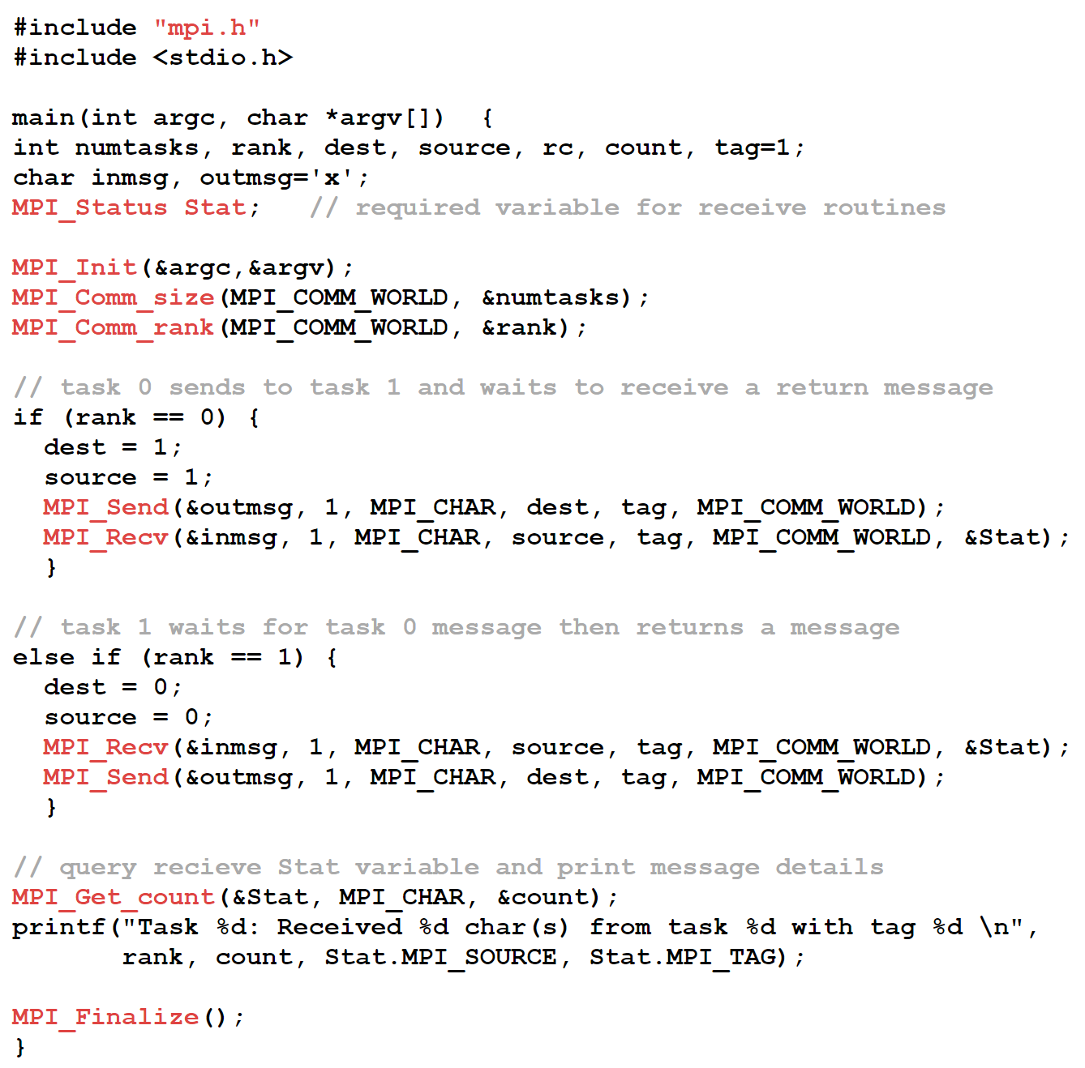
Source: https://computing.llnl.gov/tutorials/mpi/

Slide 12
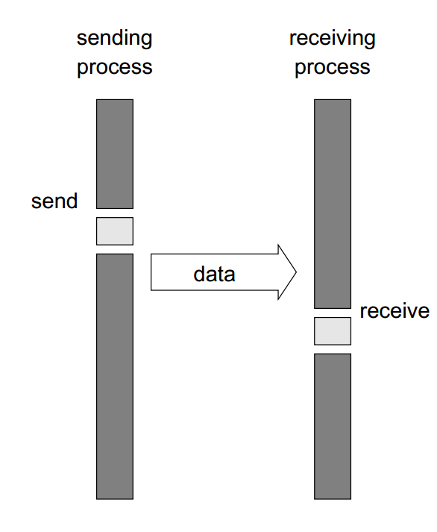
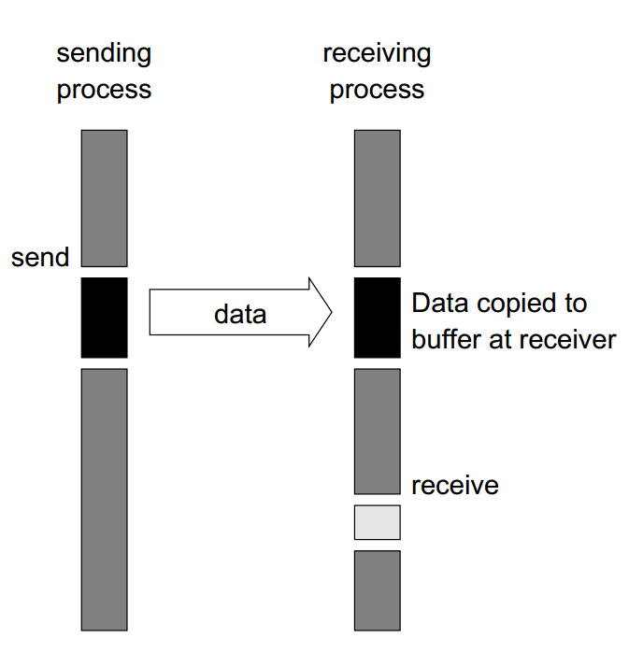
Blocking communication
MPI_Send is blocking: the function won’t return immediately after being called.
Blocking ensures the data is correctly sent.
Sender and receiver aren’t synchronized, so sender must wait until receiver is ready.
Waiting time depends on if an MPI implementation uses a hardware send buffer.
If there’s a buffer, MPI_Send returns after data copied from application buffer to hardware buffer.
Data is later transferred to HW buffer of receiver.
With no buffer, sender waits until matching receive occurred.
At this point, the data is either in the receiver’s hardware or application buffer.
MPI_Recv always causes process to block until data is received into its store buffer.
Source: Introduction to Parallel Computing. Grama et al.

Slide 13
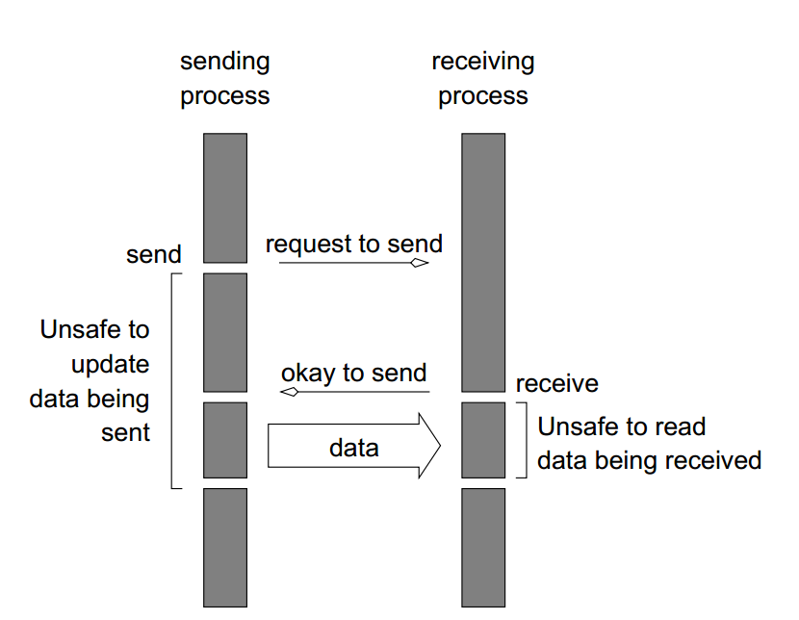
Nonblocking communication
Would be more efficient if process can immediately resume execution after calling send or receive.
This requires a HW buffer.
Process continues with computation while data is transferred from process buffer to HW buffer.
But must not modify process buffer until transfer complete.
Need functions to detect when transfer complete.
Source: Introduction to Parallel Computing. Grama et al.

Slide 14
Nonblocking communication
int MPI_Isend(void *buf, int count, MPI_Datatype type, int dest, int tag, MPI_Comm comm, MPI_Request *req);
int MPI_Irecv(void *buf, int count, MPI_Datatype type, int source, int tag, MPI_Comm comm, MPI_Request *req);
int MPI_Test(MPI_Request *req, int *flag, MPI_Status *status);
int MPI_Wait(MPI_Request *req, MPI_Status *status);
MPI_Isend and MPI_Irecv return immediately after being called.
But must still know when operations complete.
Use a request object to identify the operation.
This object used later to test completion.
Can also use to make process wait (block) until operation completes.

Slide 15
Deadlock example 1
Must be careful about ordering of sends or receives. Otherwise processes can deadlock, i.e. wait forever.
int a[10], b[10], myrank;
MPI_Status status;
...
MPI_Comm_rank(MPI_COMM_WORLD, &myrank);
if (myrank == 0) {
MPI_Send(a, 10, MPI_INT, 1, 1,
MPI_COMM_WORLD);
MPI_Send(b, 10, MPI_INT, 1, 2,
MPI_COMM_WORLD);
}
else if (myrank == 1) {
MPI_Recv(b, 10, MPI_INT, 0, 2,
MPI_COMM_WORLD);
MPI_Recv(a, 10, MPI_INT, 0, 1,
MPI_COMM_WORLD);}
int a[10], b[10], myrank;
MPI_Status status;
...
MPI_Comm_rank(MPI_COMM_WORLD, &myrank);
if (myrank == 0) {
MPI_Send(a, 10, MPI_INT, 1, 1,
MPI_COMM_WORLD);
MPI_Send(b, 10, MPI_INT, 1, 2,
MPI_COMM_WORLD);
}
else if (myrank == 1) {
MPI_Recv(b, 10, MPI_INT, 0, 1,
MPI_COMM_WORLD);
MPI_Recv(a, 10, MPI_INT, 0, 2,
MPI_COMM_WORLD);}
If buffering, then probably no deadlock.
If no buffering, processes will deadlock waiting to receive from each other.
Cause is that tags are sent and received in different orders
Resolve the deadlock by using same tag order for send and recv.

Slide 16
Deadlock example 2
int a[10], b[10], npes, myrank;
MPI_Status status;
...
MPI_Comm_size(MPI_COMM_WORLD, &npes);
MPI_Comm_rank(MPI_COMM_WORLD, &myrank);
MPI_Send(a, 10, MPI_INT, (myrank+1)%npes,
1, MPI_COMM_WORLD);
MPI_Recv(b, 10, MPI_INT, (myrank-1)%npes,
1, MPI_COMM_WORLD);
int a[10], b[10], npes, myrank;
MPI_Status status;
...
MPI_Comm_size(MPI_COMM_WORLD, &npes);
MPI_Comm_rank(MPI_COMM_WORLD, &myrank);
if (myrank%2 == 0) {
MPI_Send(a, 10, MPI_INT, (myrank+1)%npes,
1, MPI_COMM_WORLD);
MPI_Recv(b, 10, MPI_INT, (myrank-1)%npes,
1, MPI_COMM_WORLD);
}
else {
MPI_Recv(b, 10, MPI_INT, (myrank-1)%npes,
1, MPI_COMM_WORLD);
MPI_Send(a, 10, MPI_INT, (myrank+1)%npes,
1, MPI_COMM_WORLD); }
Here, npes processes in a ring. Process i sends to i+1, receives from i-1.
No deadlock with buffering, since MPI_Send returns and MPI_Recv can occur.
Without buffering, processes deadlock blocking for matching receive.
Solution is to first let even numbered processes send and odd processes recv, then let odd processes send and even processes recv.
This is cumbersome. It would be nice to have built-in way to avoid deadlock.
process 0
process 1
blocking send
blocking send
blocking send
blocking send
process 3
process 2

Slide 17
Send and receive simultaneously
int MPI_Sendrecv(void *sendbuf, int sendcount, MPI_Datatype senddatatype, int dest, int sendtag, void *recvbuf, int recvcount, MPI_Datatype recvdatatype, int source, int recvtag, MPI_Comm comm, MPI_Status *status)
MPI_Sendrecv sends a message and starts a receive before blocking.
Will block until send completes and receiving application buffer receives message.
No deadlock on ring.
int a[10], b[10], npes, myrank;
MPI_Status status;
...
MPI_Comm_size(MPI_COMM_WORLD, &npes);
MPI_Comm_rank(MPI_COMM_WORLD, &myrank);
MPI_Sendrecv(a, 10, MPI_INT, (myrank+1)%npes, 1, b, 10, MPI_INT,
(myrank-1)%npes, 1, MPI_COMM_WORLD, &status);

Slide 18
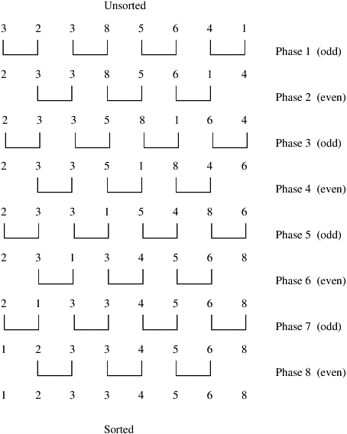
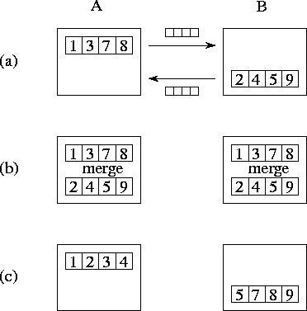
Even-odd sort
If each processor has multiple values, then instead of simply swapping them, do compare-split step.
This combines the values from two processes, and puts the smaller half in left process, larger half in right process.
Source: Introduction to Parallel Computing. Grama et al.

Slide 19
Even-odd sort in MPI
#include <stdlib.h>
#include <mpi.h> /* Include MPI's header file */
main(int argc, char *argv[])
{
int n; /* The total number of elements to be sorted */
int npes; /* The total number of processes */
int myrank; /* The rank of the calling process */
int nlocal; /* The local number of elements, and the array that stores them */
int *elmnts; /* The array that stores the local elements */
int *relmnts; /* The array that stores the received elements */
int oddrank; /* The rank of the process during odd- phase communication */
int evenrank; /* The rank of the process during even- phase communication */
int *wspace; /* Working space during the compare-split operation */
int i;
MPI_Status status;
/* Initialize MPI and get system information */
MPI_Init(&argc, &argv);
MPI_Comm_size(MPI_COMM_WORLD, &npes);
MPI_Comm_rank(MPI_COMM_WORLD, &myrank);
n = atoi(argv[1]);
nlocal = n/npes; /* Compute the number of elements to be stored locally. */
/* Allocate memory for the various arrays */
elmnts = (int *)malloc(nlocal*sizeof(int));
relmnts = (int *)malloc(nlocal*sizeof(int));
wspace = (int *)malloc(nlocal*sizeof(int));
/* Fill-in the elmnts array with random elements */
srandom(myrank);
for (i=0; i<nlocal; i++)
elmnts[i] = random();
/* Sort the local elements using the built-in quicksort routine */
qsort(elmnts, nlocal, sizeof(int), IncOrder);
/* Determine the rank of the processors that myrank needs to communicate with during the */
/* odd and even phases of the algorithm */
if (myrank%2 == 1) {
oddrank = myrank-1;
evenrank = myrank+1;
}
else {
oddrank = myrank+1;
evenrank = myrank-1;
}
Source: Introduction to Parallel Computing. Grama et al.

Slide 20
Even-odd sort in MPI
/* Set first processor’s communication ranks */
if (oddrank == -1 || oddrank == npes)
oddrank = MPI_PROC_NULL;
if (evenrank == -1 || evenrank == npes)
evenrank = MPI_PROC_NULL;
/* Main loop of the odd-even sorting algorithm */
for (i=0; i<npes-1; i++) {
if (i%2 == 1) /* Odd phase */
MPI_Sendrecv(elmnts, nlocal, MPI_INT, oddrank, 1, relmnts, nlocal, MPI_INT, oddrank, 1, MPI_COMM_WORLD, &status);
else /* Even phase */
MPI_Sendrecv(elmnts, nlocal, MPI_INT, evenrank, 1, relmnts, nlocal, MPI_INT, evenrank, 1, MPI_COMM_WORLD, &status);
CompareSplit(nlocal, elmnts, relmnts, wspace,
myrank < status.MPI_SOURCE);
}
free(elmnts); free(relmnts); free(wspace);
MPI_Finalize();
}
CompareSplit(int nlocal, int *elmnts, int *relmnts, int *wspace, int keepsmall) {
int i, j, k;
for (i=0; i<nlocal; i++)
wspace[i] = elmnts[i];
/* Copy the elmnts array into the wspace array */
if (keepsmall) { /* Keep nlocal smaller elts */
for (i=j=k=0; k<nlocal; k++) {
if (j == nlocal || (i < nlocal && wspace[i] < relmnts[j]))
elmnts[k] = wspace[i++];
else
elmnts[k] = relmnts[j++];
}}
else { /* Keep the nlocal larger elements */
for (i=k=nlocal-1, j=nlocal-1; k>=0; k--) {
if (j == 0 || (i >= 0 && wspace[i] >= relmnts[j]))
elmnts[k] = wspace[i--];
else
elmnts[k] = relmnts[j--];
}}}
int IncOrder(const void *e1, const void *e2) {
return (*((int *)e1) - *((int *)e2));
}

Slide 21
Collective communication
Collective communication are routines that provide message passing between a group of processes.
One-to-many, e.g. broadcast, scatter
Many-to-one, e.g. gather, reduce
Many-to-many, e.g. All-to-all
Collective communication may be implemented using point-to-point routines.
Specialized implementation of collective communication is likely to be more efficient.
Collectives are blocking in MPI 1 and 2, but MPI 3 includes nonblocking collectives.

Slide 22
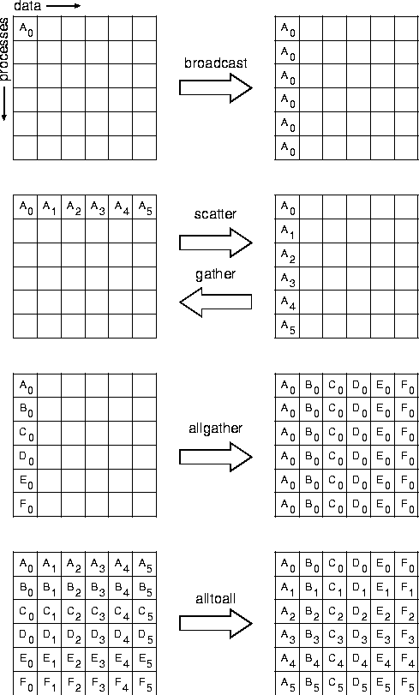
Collective communication
As with point to point communication, need to specify the communicator.
MPI_Bcast()
MPI_Reduce()
MPI_Allreduce()
MPI_Scan()
MPI_Gather()
MPI_Scatter()
MPI_Scatterv()
MPI_Alltoall()
MPI_Alltoallv()
MPI_Barrier()
Source: http://www.mpi-forum.org/docs/mpi-1.1/mpi-11-html/coll-fig1.gif

Slide 23
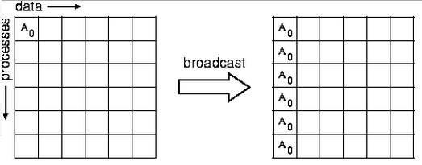
Broadcast
int MPI_Bcast(void *buf, int count, MPI_Datatype type, int source, MPI_Comm comm)
Send the data in buf at the source process to all processes (including source) in comm.
Non-source nodes store the incoming data in their buf.
Note that even though the message is coming from source, all processes, including the receiving ones, call MPI_Bcast().
See the example on the next slide.

Slide 24
Broadcast example
#include <mpi.h>
int main(int argc, char** argv) {
int myrank;
int buf;
const int root=0;
MPI_Init(&argc, &argv);
MPI_Comm_rank(MPI_COMM_WORLD, &myrank);
if (myrank == root) {
buf = 1; }
/* All procs call bcast. buf is sent from
root to all procs */
MPI_Bcast(&buf, 1, MPI_INT, root, MPI_COMM_WORLD);
MPI_Finalize();
return 0;
}
This code causes process root to send buf (i.e. the value 1) to all the processes.
Since MPI uses an SPMD model, all processes run the same code.
So even the non-root processes do MPI_Bcast(&buf, 1, MPI_INT, root, MPI_COMM_WORLD)
However, since their myrank != root, then instead of sending, the MPI_Bcast() will cause them to receive.
Think of MPI_Bcast() as saying “participate in a broadcast”, with the type of participation depending on the process’s rank.
The other collective operations work similarly, i.e. all procs run the same code, but do different things depending on their rank.

Slide 25
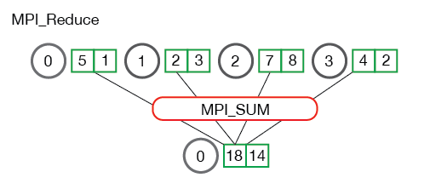
Reduce
int MPI_Reduce(void *sendbuf, void *recvbuf, int count, MPI_Datatype type, MPI_Op op, int target, MPI_Comm comm)
Combine the elements stored in the buffer sendbuf of each process in comm using the operation op, and store the combined values in recvbuf of process target.
Ex Add the values from all the processes.
Operations include MPI_MAX, MPI_MIN, MPI_SUM, MPI_PROD, MPI_LAND, MPI_MAXLOC.
MPI_MAXLOC p returns a pair of values (v,l) in recvbuf, where v is the max value, and l is the smallest ranked process with the value.
Source: http://mpitutorial.com/tutorials/mpi-reduce-and-allreduce/

Slide 26
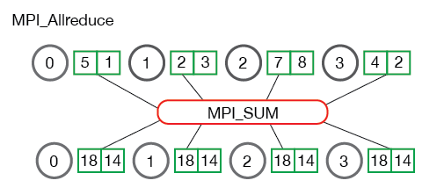
Allreduce
int MPI_Allreduce(void *sendbuf, void *recvbuf, int count, MPI_Datatype type, MPI_Op op, MPI_Comm comm)
Same as reduce, but store the result at all the processes.
Source: http://mpitutorial.com/tutorials/mpi-reduce-and-allreduce/

Slide 27
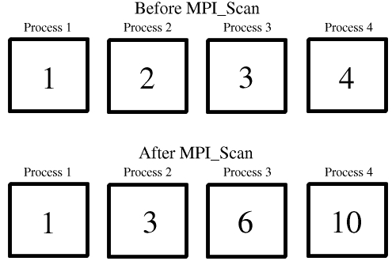
Scan
int MPI_Scan(void *sendbuf, void *recvbuf, int count, MPI_Datatype type, MPI_Op op, MPI_Comm comm)
List the data in the sendbuf’s of all the processes by process rank.
Process i applies op (elementwise) to the first i sendbuf’s and stores the result in its recvbuf.
Ex Add values from the processes.
This operation is also called prefix sum.
Can apply other operators besides sum, as in reduce.
Source: http://www.rc.usf.edu/tutorials/ classes/tutorial/mpi/images/scan_ex.jpg

Slide 28
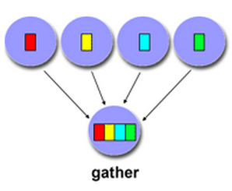
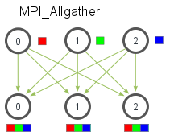
Gather
int MPI_Gather(void *sendbuf, int sendcount, MPI_Datatype sendtype, void *recvbuf, int recvcount, MPI_Datatype recvtype, int target, MPI_Comm comm)
int MPI_Allgather(void *sendbuf, int sendcount, MPI_Datatype sendtype, void *recvbuf, int recvcount, MPI_Datatype recvtype, MPI_Comm comm)
Gather collects the sendbuf’s from all the processes in comm into the recvbuf of process target.
If k processes in comm each with sendbuf of size t, then target will receive k*t items.
Allgather collects this data at all the processes.

Slide 29
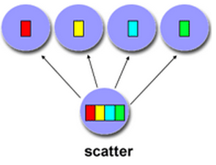
Scatter
int MPI_Scatter(void *sendbuf, int sendcount, MPI_Datatype sendtype, void *recvbuf, int recvcount, MPI_Datatype recvtype, int source, MPI_Comm comm)
int MPI_Scatterv(void *sendbuf, int *sendcounts, int *displs, MPI_Datatype sendtype, void *recvbuf, int recvcount, MPI_Datatype recvtype, int source, MPI_Comm comm)
Scatter sends the data at location i*recvcount in sendbuf to the recvbuf of i’th process in comm.
All scattered data have the same size.
Scatterv sends data of different sizes to different processes.
Sizes of data specified in sendcounts.
Data to send to process i starts at location displs[i] in sendbuf.
For the receiving processes (i.e. all processes other than source), the first 4 arguments don’t matter.
Each receiving process sets recvcount to the number of items it expects to get.
Source: https://computing.llnl.gov/ tutorials/mpi/

Slide 30
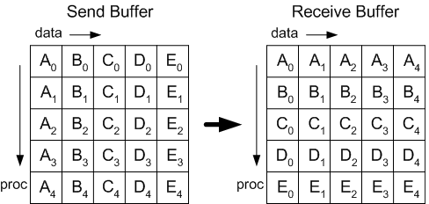
Alltoall
int MPI_Alltoall(void *sendbuf, int sendcount, MPI_Datatype sendtype, void *recvbuf, int recvcount, MPI_Datatype recvtype, MPI_Comm comm)
int MPI_Alltoallv(void *sendbuf, int *sendcounts, int *sdispls, MPI_Datatype sendtype, void *recvbuf, int *recvcounts, int *rdispls, MPI_Datatype recvtype, MPI_Comm comm)
Alltoall sends to process i sendcount elements from sendbuf starting from location i*sendcount of sendbuf.
Alltoallv is similar, but allows sending different size data to each process.
Source: https://cvw.cac.cornell.edu/ MPIcc/alltoall

Slide 31
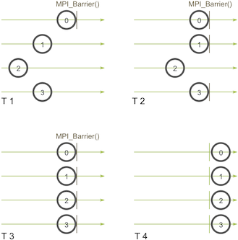
Barrier
int MPI_Barrier(MPI_Comm comm)
Used to synchronize all the processes in comm at a certain point in the code before any of them can proceed.
All processes in comm must reach the barrier. Otherwise, all processes will block forever.
Can use multiple barriers.
All processes must reach the b’th barrier before proceeding to barrier b+1.
Source: http://mpitutorial.com/tutorials/mpi-broadcast-and-collective-communication/barrier.png

Slide 32
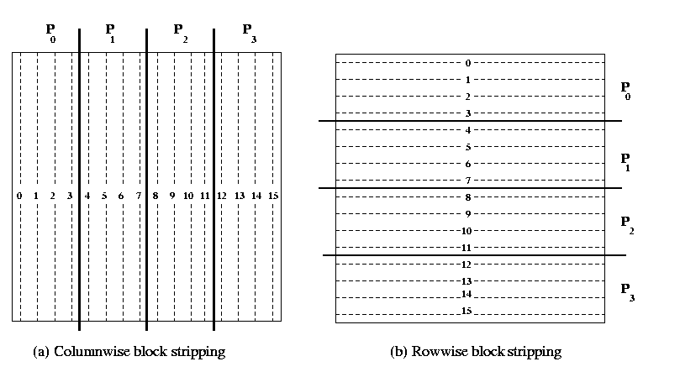
Storing a matrix
Linear algebra one of the main applications for parallel computing.
A large matrix can be stored in a distributed fashion on the parallel processors using row or column striping.
Even with columnwise block stripping, we store columns in row-major format.
Source: http://www.cse.iitd.ernet.in/ ~dheerajb/MPI/Document/onedblk.gif

Slide 33
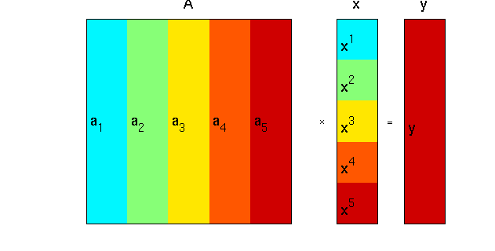
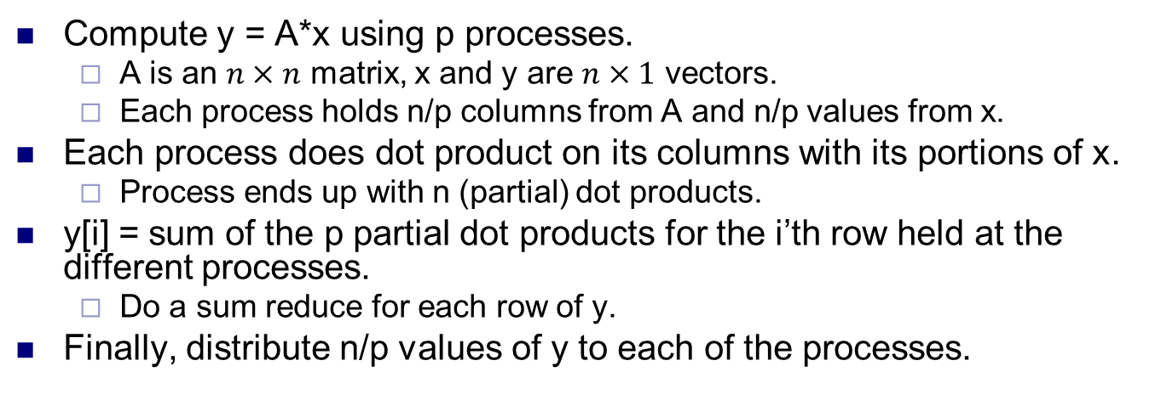
Column-wise matrix vector mult
Compute y = A*x using p processes.
A is an $n×n$ matrix, x and y are $n×1$ vectors.
Each process holds n/p columns from A and n/p values from x.
Each process does dot product on its columns with its portions of x.
Process ends up with n (partial) dot products.
y[i] = sum of the p partial dot products for the i’th row held at the different processes.
Do a sum reduce for each row of y.
Finally, distribute n/p values of y to each of the processes.
Source: https://www.informatik.uni-konstanz.de/fileadmin/informatik/ag-saupe/Webpages/lehre/na_08/Lab1/1_Preliminaries/html/matrixVectorProduct.html

Slide 34
Column-wise matrix vector mult
ColMatrixVectorMultiply(int n, double *a, double *x, double *y, MPI_Comm comm)
{
int i, j;
int nlocal;
double *py;
double *fy;
int npes, myrank;
MPI_Status status;
/* Get communicator information */
MPI_Comm_size(comm, &npes);
MPI_Comm_rank(comm, &myrank);
nlocal = n/npes;
/* Allocate memory for arrays storing intermediate results. */
py = (double *) malloc(n*sizeof(double));
fy = (double *) malloc(n*sizeof(double));
/* Compute partial-dot products that correspond to local columns of A*/
for (i=0; i<n; i++) {
py[i] = 0.0;
for (j=0; j<nlocal; j++)
py[i] += a[i*nlocal+j]*x[j];
}
/* Sum-up results by performing an element-wise reduction operation */
MPI_Reduce(py, fy, n, MPI_DOUBLE, MPI_SUM, 0, comm);
/* Redistribute fy in a fashion similar to vector x */
MPI_Scatter(fy, nlocal, MPI_DOUBLE, y, nlocal, MPI_DOUBLE, 0, comm);
free(py); free(fy);
}
Source: Introduction to Parallel Computing. Grama et al.

Slide 35
Derived data types
MPI comes with a number of standard built in types.
To send more complicated data structures, programmer defines derived types.
Four main types, contiguous, vector, indexed and struct.
MPI_Type_commit(&datatype) commits defined datatype.
MPI_Type_extent(&datatype) returns size in bytes of the datatype.
MPI_Type_free(&datatype) Deallocates a datatype, prevent memory exhaustion.

Slide 36
Defining new datatypes
MPI_Type_contiguous(count, oldtype, &newtype)
Place count copies of oldtype contiguously.
MPI_Type_vector(count, blocklength, stride, oldtype, &newtype)
Similar to contiguous, use count copies of oldtype each of blocklength, with stride bytes in between.
MPI_Type_indexed (count, blocklens[], offsets[], old_type, &newtype)
Similar to vector, except blocklens and offsets vectors (of size count) specify size and offset of each element in the datatype.
MPI_Type_struct (count,blocklens[], offsets[], old_types, &newtype)
Form a datatype according to a completely defined map of the component data types.

Slide 37
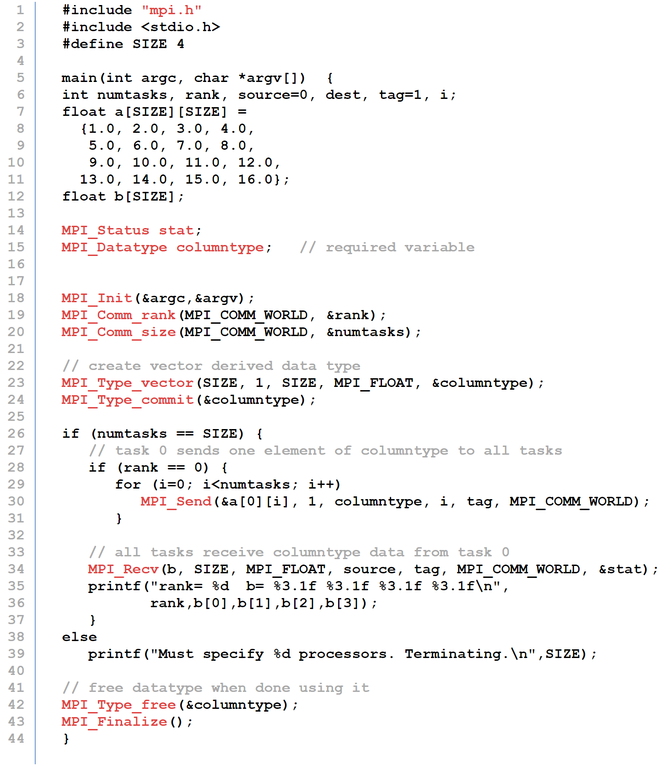
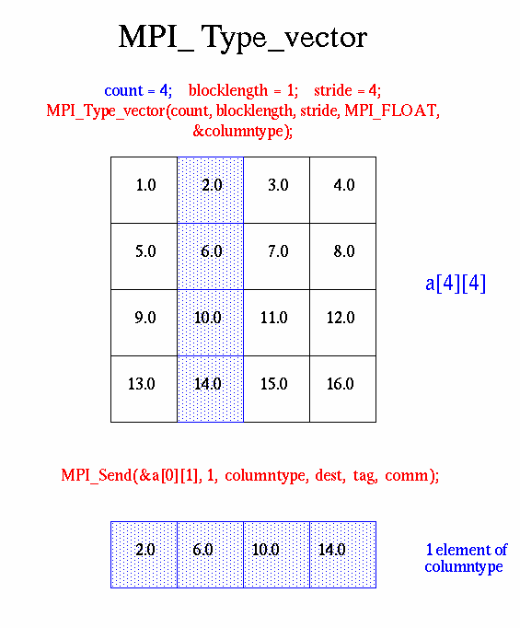
rank= 0 b= 1.0 5.0 9.0 13.0
rank= 1 b= 2.0 6.0 10.0 14.0
rank= 2 b= 3.0 7.0 11.0 15.0
rank= 3 b= 4.0 8.0 12.0 16.0
Source: https://computing.llnl.gov/tutorials/mpi

Slide 38
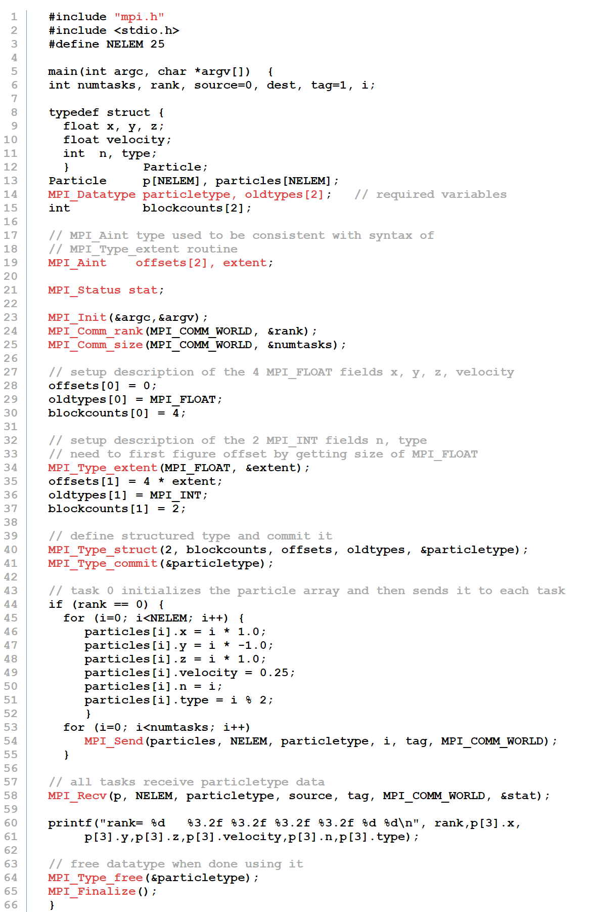
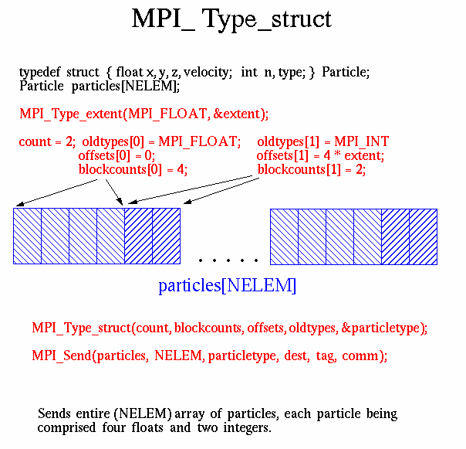
rank= 0 3.00 -3.00 3.00 0.25 3 1
rank= 2 3.00 -3.00 3.00 0.25 3 1
rank= 1 3.00 -3.00 3.00 0.25 3 1
rank= 3 3.00 -3.00 3.00 0.25 3 1

Slide 39
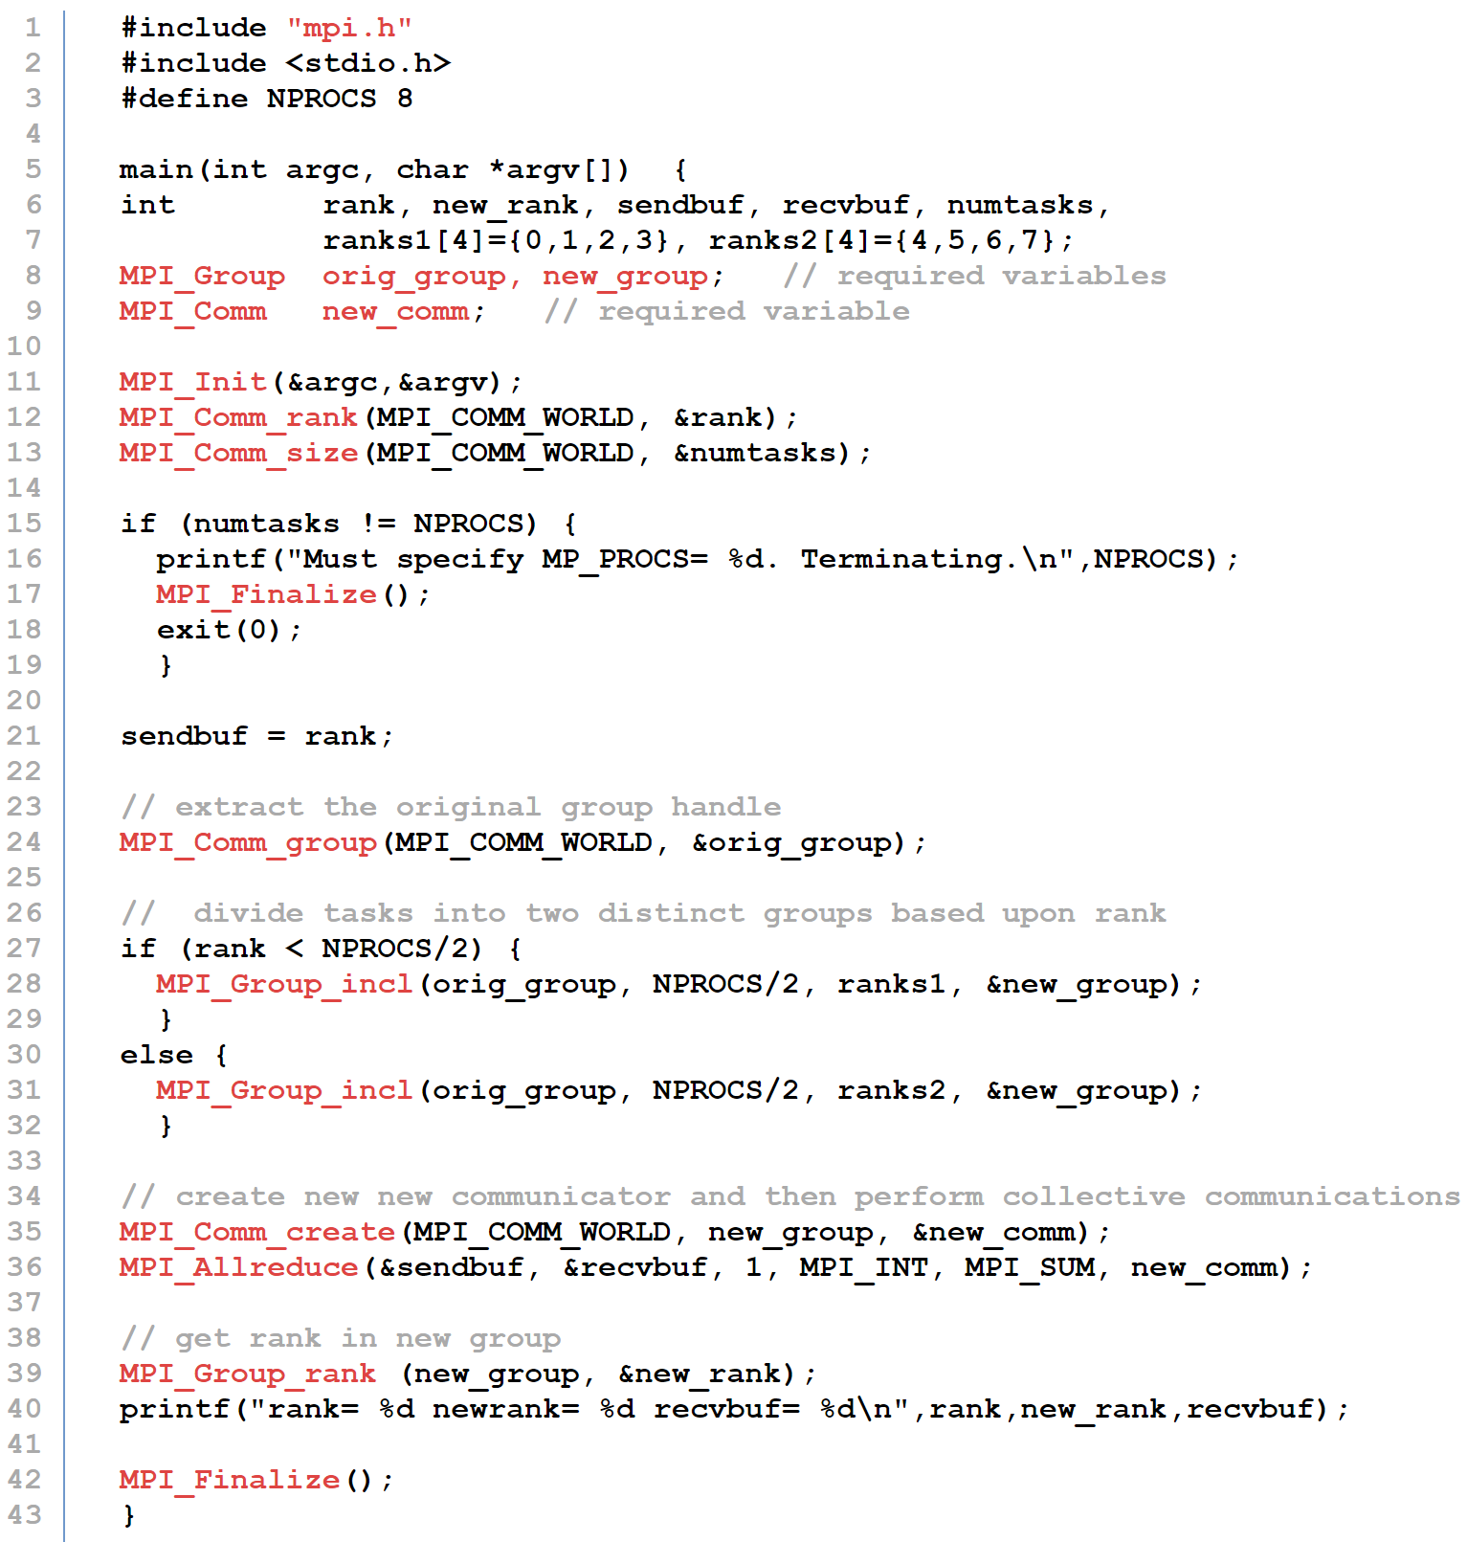
More on communicators
Communicators are a programming aid to group processes that perform a common task.
Collective computations are done within a communicator.
MPI 2 allows collectives between communicators.
Processes have a unique rank in each communicator they belong to.
rank= 7 newrank= 3 recvbuf= 22
rank= 0 newrank= 0 recvbuf= 6
rank= 1 newrank= 1 recvbuf= 6
rank= 2 newrank= 2 recvbuf= 6
rank= 6 newrank= 2 recvbuf= 22
rank= 3 newrank= 3 recvbuf= 6
rank= 4 newrank= 0 recvbuf= 22
rank= 5 newrank= 1 recvbuf= 22

Slide 40
Virtual topologies
Map a communicator of processes to a virtual topology.
Virtual topology may not correspond to the physical topology of underlying hardware.
Nevertheless, allows MPI implementation to try to optimize mapping of virtual to physical topology, e.g. mapping a virtual mesh to a physical hypercube.
Also a programming convenience, to match topology of application communications to virtual topology.
A 3D physics code can use a virtual 3D mesh topology.
Main topologies are regular torus and graph.
MPI_Cart_create(MPI_Comm oldcomm, int ndim, int dims[], int qperiodic[], int qreorder, MPI_Comm *newcomm)
MPI_Dist_graph_create_adjacent(MPI_Comm oldcomm, int indegree, int sources[], int sourceweights[], int outdegree, int dests[], int destweights[], MPI_Info info, int qreorder, MPI_Comm *newcomm)

Slide 41
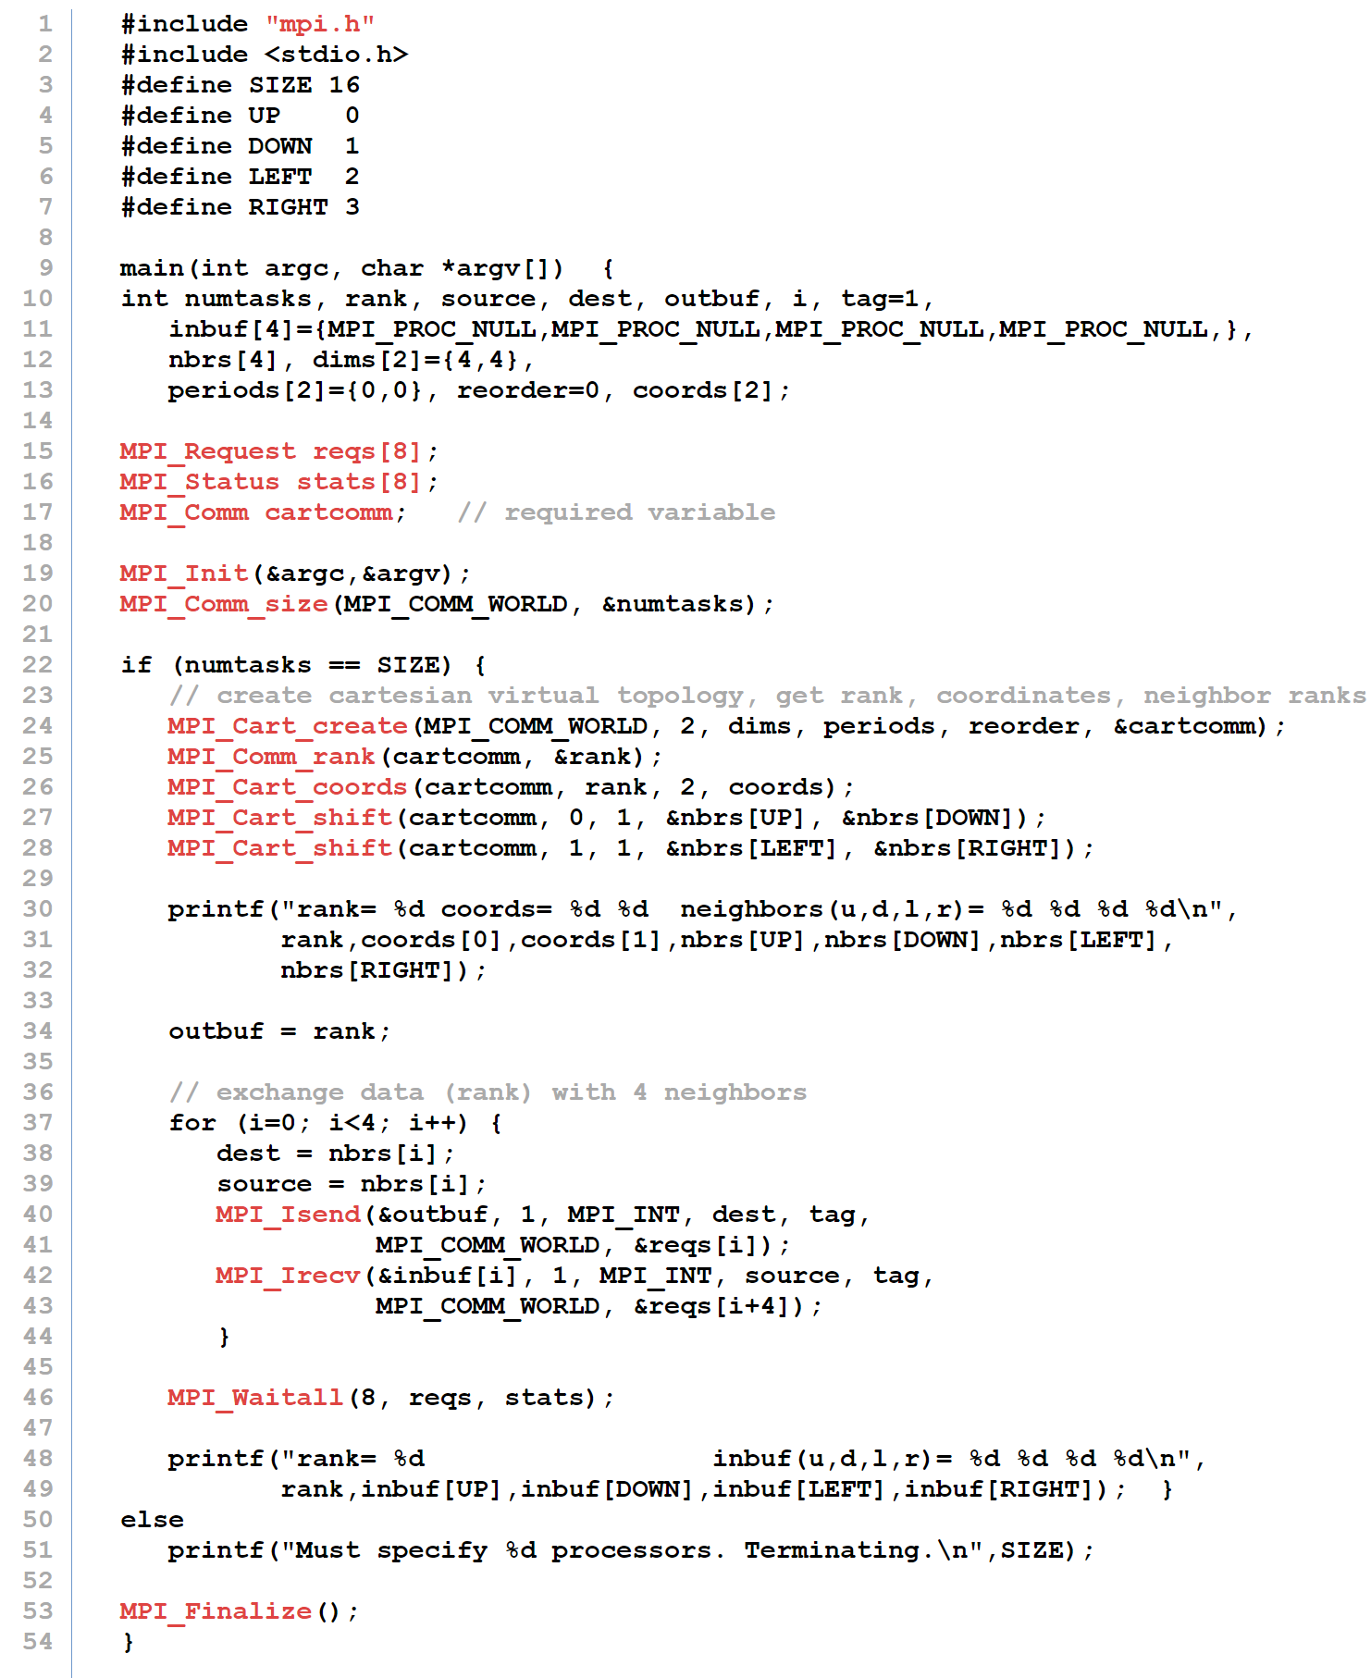

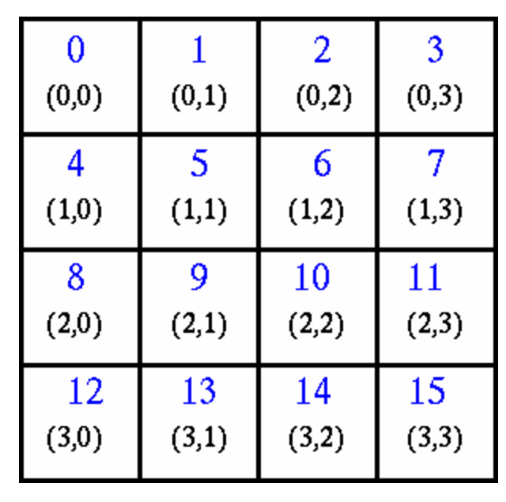
rank= 0 coords= 0 0 neighbors(u,d,l,r)= -1 4 -1 1
rank= 0 inbuf(u,d,l,r)= -1 4 -1 1
rank= 8 coords= 2 0 neighbors(u,d,l,r)= 4 12 -1 9
rank= 8 inbuf(u,d,l,r)= 4 12 -1 9
rank= 1 coords= 0 1 neighbors(u,d,l,r)= -1 5 0 2
rank= 1 inbuf(u,d,l,r)= -1 5 0 2
rank= 13 coords= 3 1 neighbors(u,d,l,r)= 9 -1 12 14
rank= 13 inbuf(u,d,l,r)= 9 -1 12 14
...
...
rank= 3 coords= 0 3 neighbors(u,d,l,r)= -1 7 2 -1
rank= 3 inbuf(u,d,l,r)= -1 7 2 -1
rank= 11 coords= 2 3 neighbors(u,d,l,r)= 7 15 10 -1
rank= 11 inbuf(u,d,l,r)= 7 15 10 -1
rank= 10 coords= 2 2 neighbors(u,d,l,r)= 6 14 9 11
rank= 10 inbuf(u,d,l,r)= 6 14 9 11
rank= 9 coords= 2 1 neighbors(u,d,l,r)= 5 13 8 10
rank= 9 inbuf(u,d,l,r)= 5 13 8 10

Slide 42
MPI 2 and 3
MPI 2 added
Dynamic process creation.
Collectives across communicators.
Parallel I/O.
One sided communication.
Access memory on a remote process without it “expecting it”.
MPI 3 added
Nonblocking collectives.
Better support for multi-threading.
Improved one sided commuications.

